Slide 1
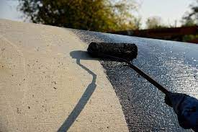
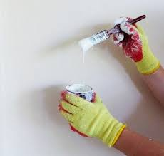
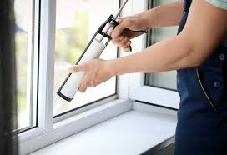
Reasons for proper preparation of surfaces before work begins.
Waterproofing Painting Glazing
1. Surface condition assessment.
2. Removal of old waterproofing, coating and window sealing.
3. Remove oils, chlorides and other contaminants.
4. Remove loose parts of the surface.
5. Profile the surface.
6. Dry the surface.

